Slide 1
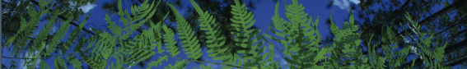

04 - Climate Processing
University of Florida
Shelly Gaynor

Slide 2
Layer Processing
Need layers in ASCII format
Clip layers to fit your desired range
Dynamic alpha hull
+ 80th quartile buffer
Remove layers with collinearity based on variable inflation factor and permutation importance.
Define (1) shared projection layers and (2) training layers.
03_ClimateProcessing.R

Slide 3
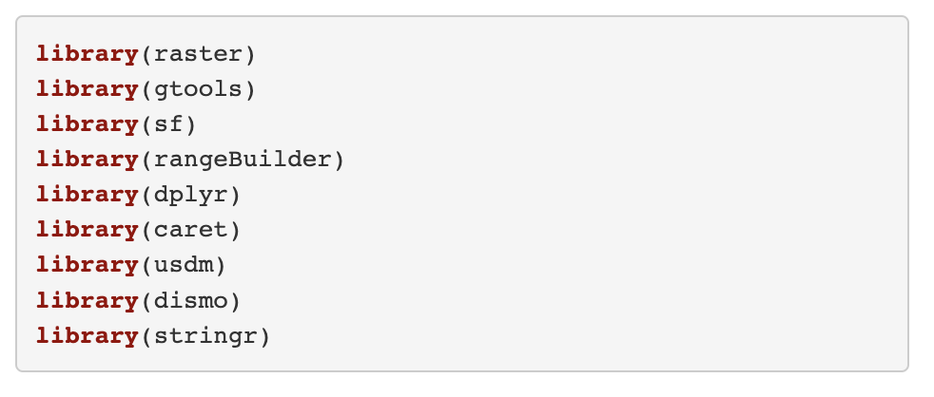
Load Packages

Slide 4
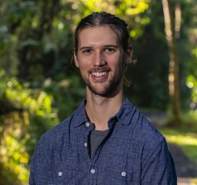
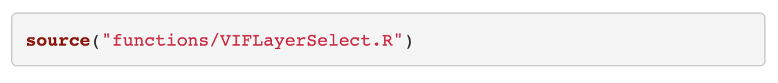
Load Functions
Dr. Mike Belitz
These functions are modified from mbelitz/Odo_SDM_Rproj (GitHub)

Slide 5
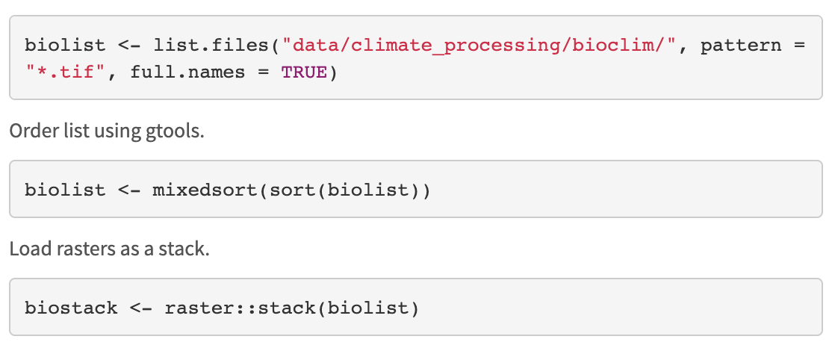
Load bioclim layers

Slide 6
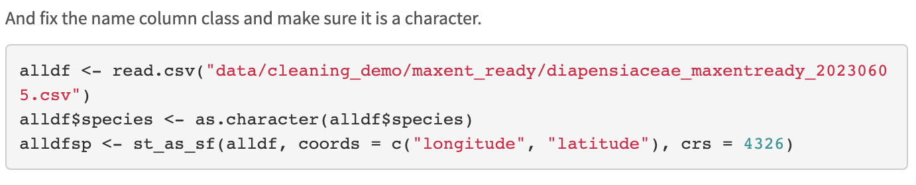
Load occurrence records

Slide 7
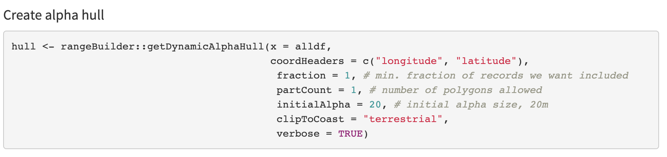
Define extent

Slide 8
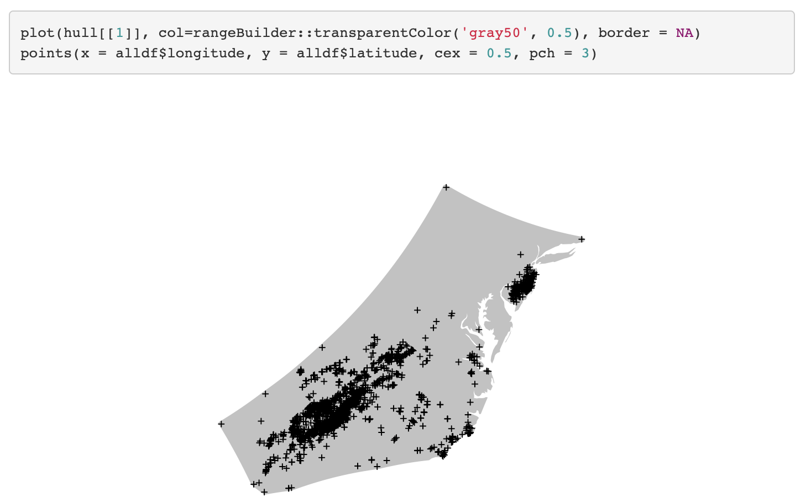
Define extent

Slide 9
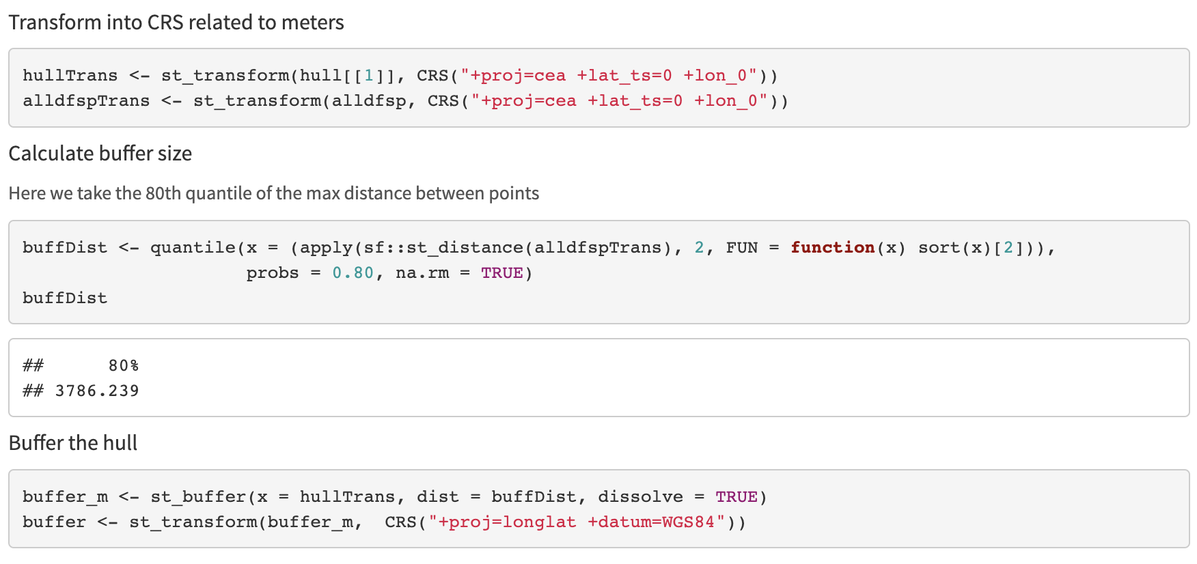
Define extent

Slide 10
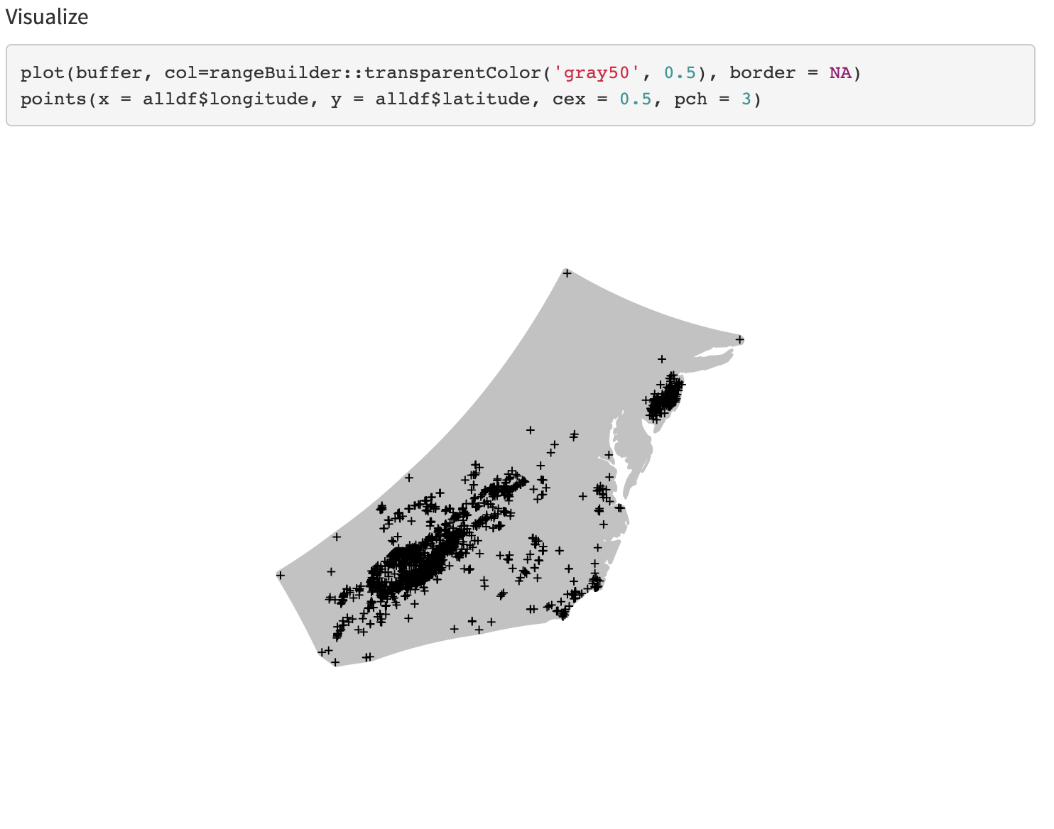
Define extent

Slide 11
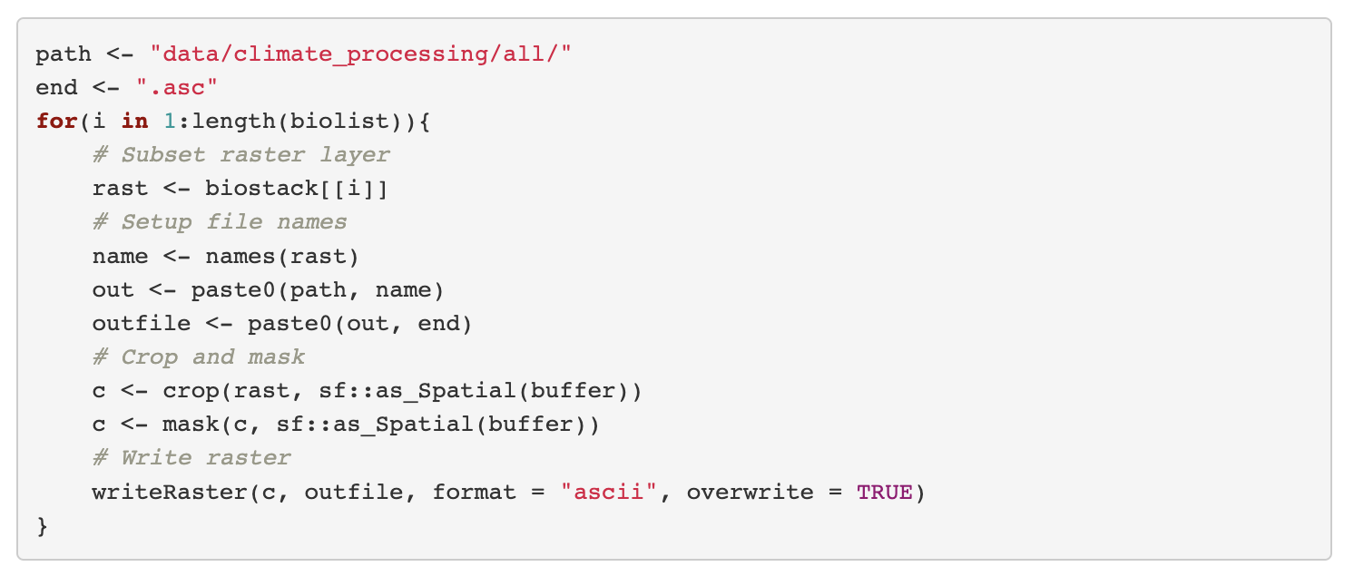
Mask and Crop Layers

Slide 12
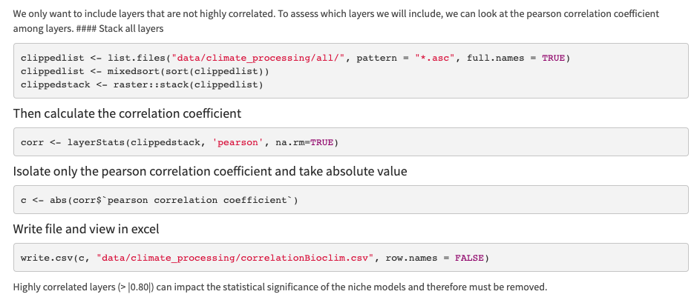
WARNING: TIME INTENSIVE
Select layers

Slide 13
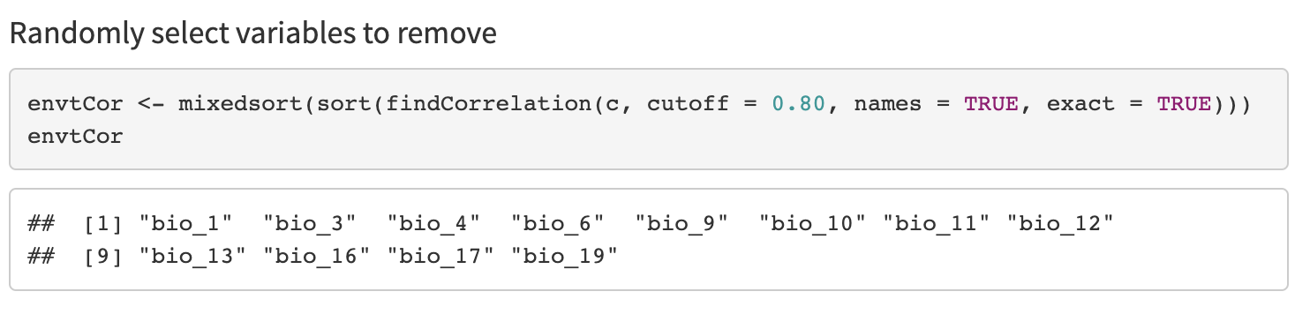
Select layers

Slide 14
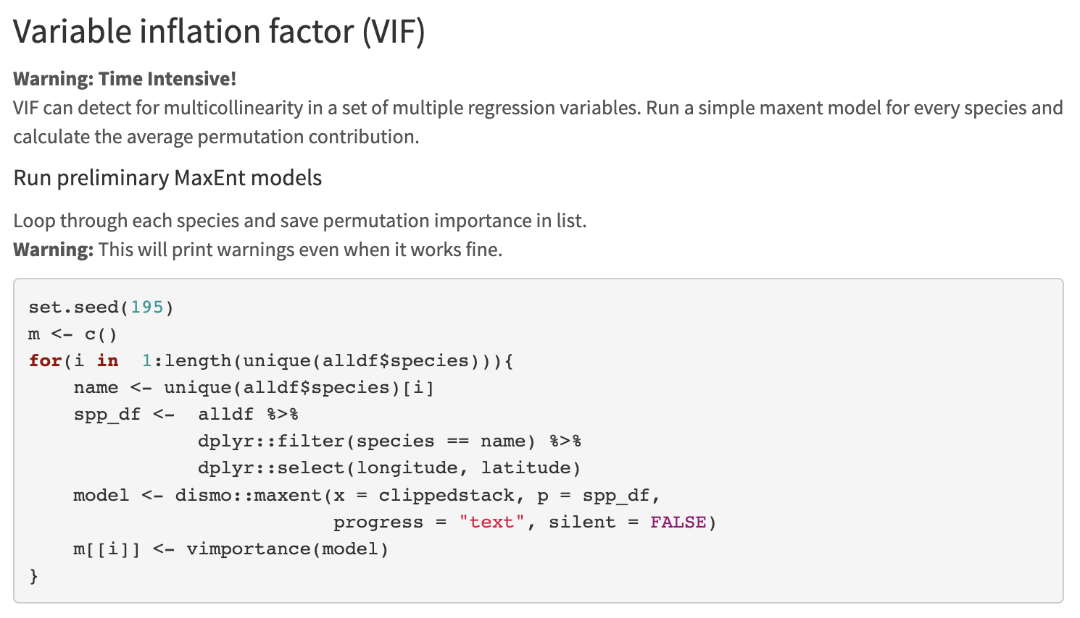
WARNING: TIME INTENSIVE
Select layers

Slide 15
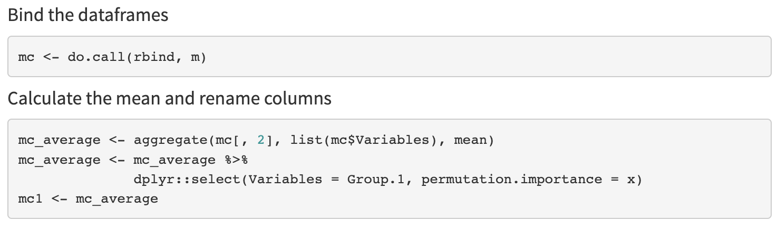
Select layers

Slide 16
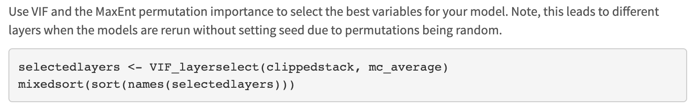
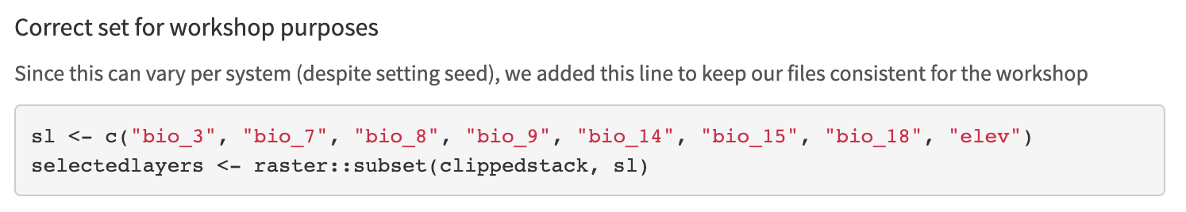
Select layers

Slide 17
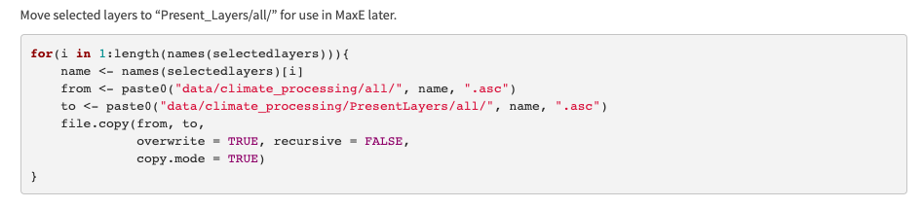
Select layers

Slide 18
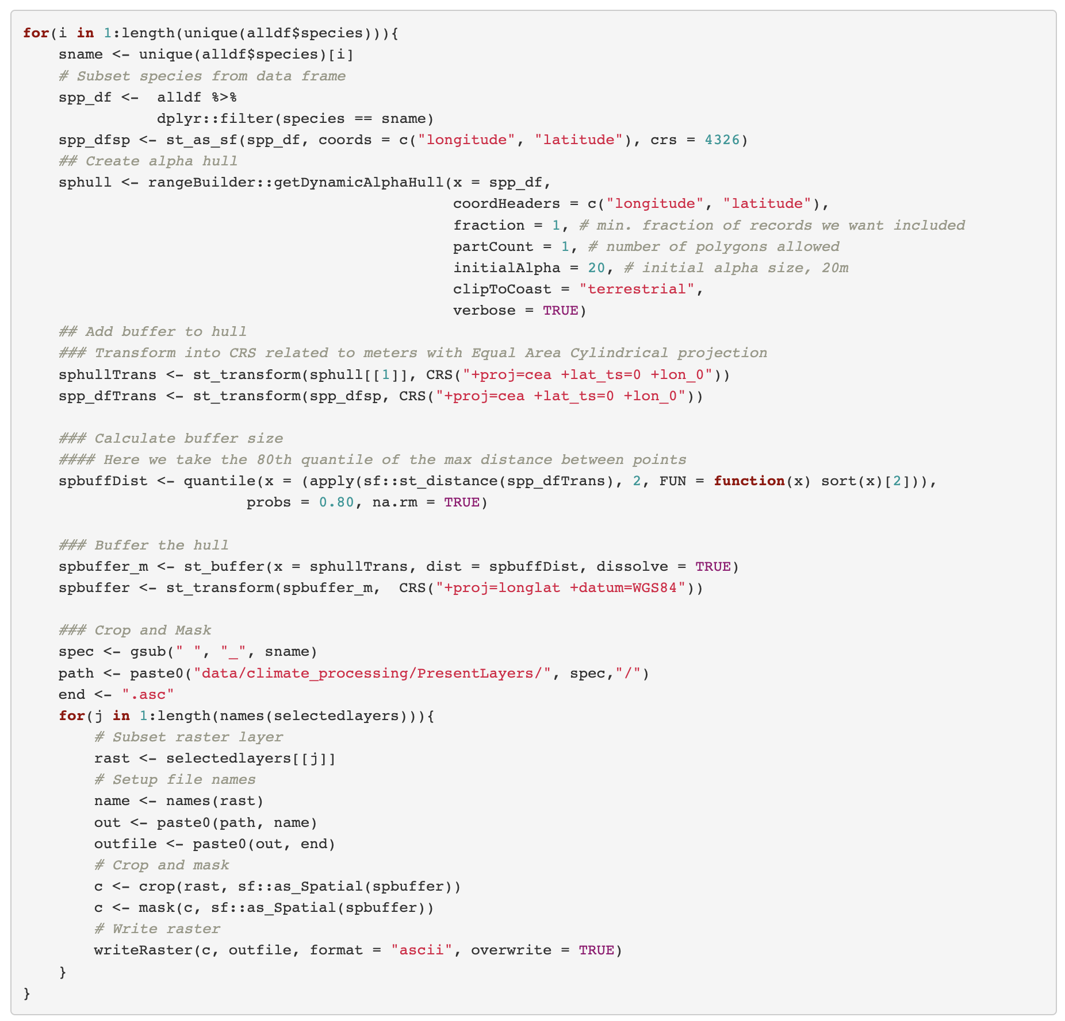
WARNING: TIME INTENSIVE
Create Species Training Layers

Slide 19
WARNING: TIME INTENSIVE
Create Species Training Layers

